Slide 1
Evaluation of terminal sire breeds for hair sheep production systems on lamb birth, weaning and grazing performance: Year 3
A.R. Weaver¹, D.L. Wright¹, D.R. Notter¹, A.M. Zajac¹, S.A. Bowdridge², and S.P. Greiner¹
¹Virginia Tech, Blacksburg, VA
²West Virginia University, Morgantown, WV

Slide 2
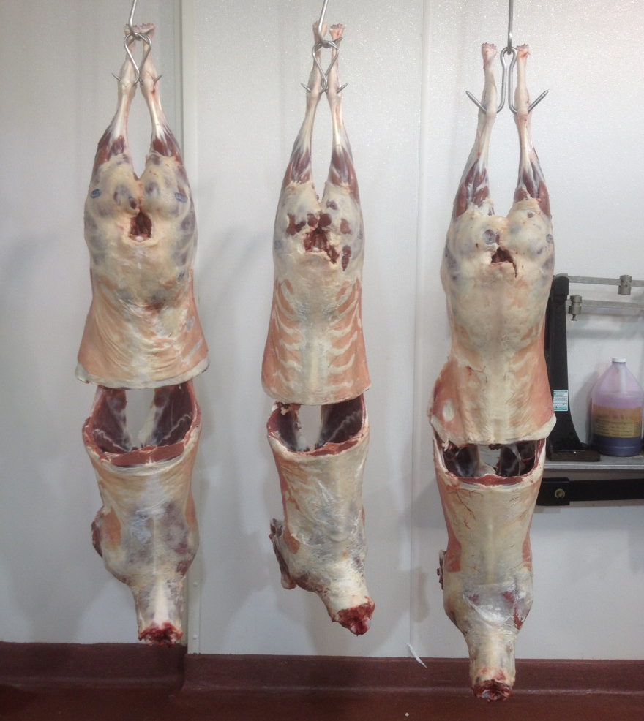
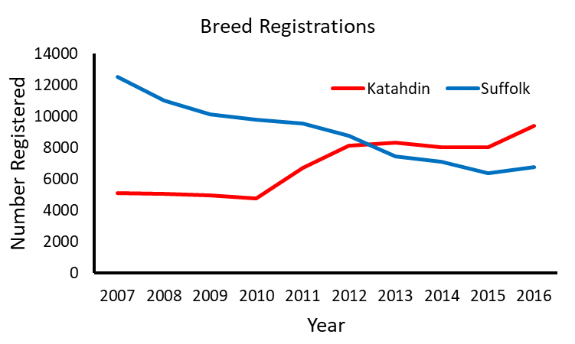
Introduction
Purebred Katahdin

Slide 3
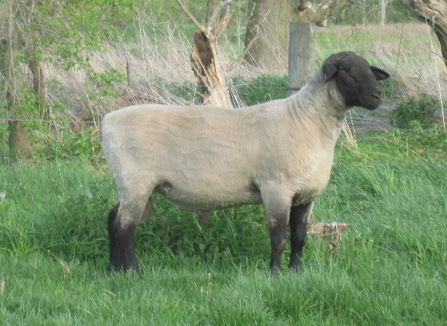
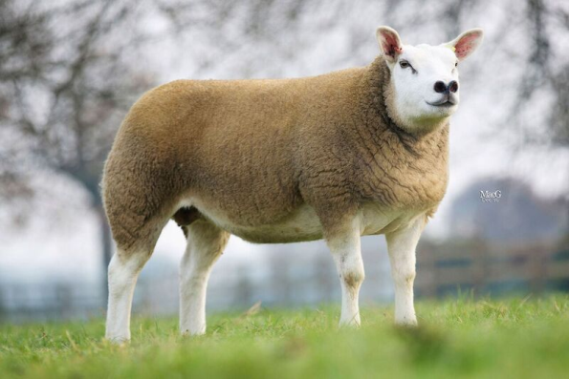
Terminal Sire Options
Suffolk
Texel
Traditional terminal sire
Fast growth
Muscle development
Moderate mature size
Forage adaptability???

Slide 4
Objective
Evaluate the efficacy of terminal sire breeds in hair sheep production systems to produce higher valued market lambs in terms of survivability, growth and parasite resistance

Slide 5
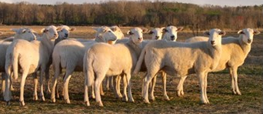
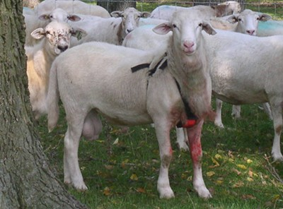
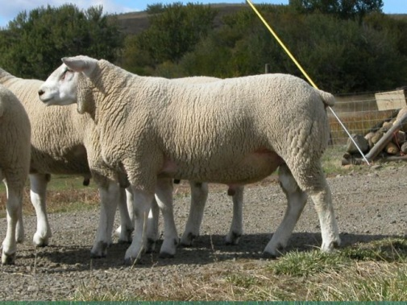
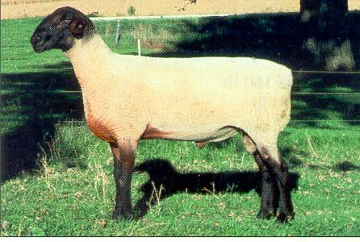
Experimental Design- Animals
Katahdin Ewes (n = 52)
n = 19
n = 19
n = 14
Texel Ram (n = 2)
Katahdin Ram (n = 2)
Suffolk Ram (n = 2)
Purebred Katahdin Lambs (n = 31 weaned, 13 male progeny)
Suffolk – Sired Lambs (n = 24 weaned,
20 male progeny)
Texel – Sired Lambs (n = 34 weaned,
17 male progeny)

Slide 6
Experimental Design
Management- Forage Based System
Southwest Virginia Agriculture Research and Extension Center, Glade Spring, VA
Spring-Born Lambs
Weaned Early June (70 d)
Summer Grazing Trial (90 d)
Male progeny only
Grazing Trial Management
  BW, FAMACHA, FEC and PCV every 14 d
  Dewormed at FAMACHA score ≥ 3

Slide 7
Statistical Analysis
SAS (SAS Institute Inc., Cary, NC)
  Proc GLM: fixed effects of sire breed
  Proc MIXED for repeated measures analysis
  Tukey’s HSD test was used for a comparative means analysis

Slide 8

Year 1 and 2 Summary
Trait | Katahdin | Suffolk | Texel
Survivability
Birth Weight
Weaning Weight
Post Grazing Weight
Harvest and Carcass WT
12th Rib Fat
LMA
Leg Score
Parasite Resistance

Slide 9
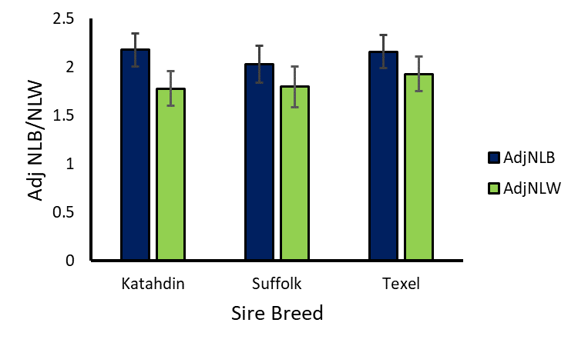
Adj. Number Born/Weaned
NLB: P = 0.83
NLW: P = 0.82

Slide 10
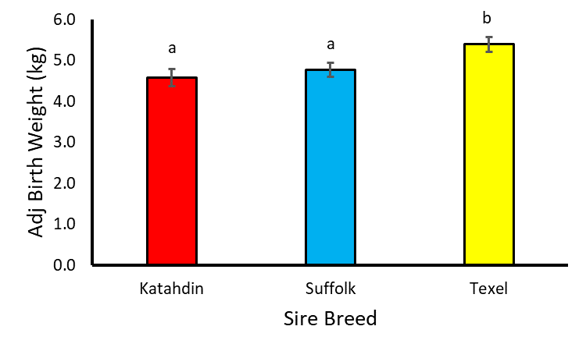
Adj. Birth Weights
P < 0.01

Slide 11
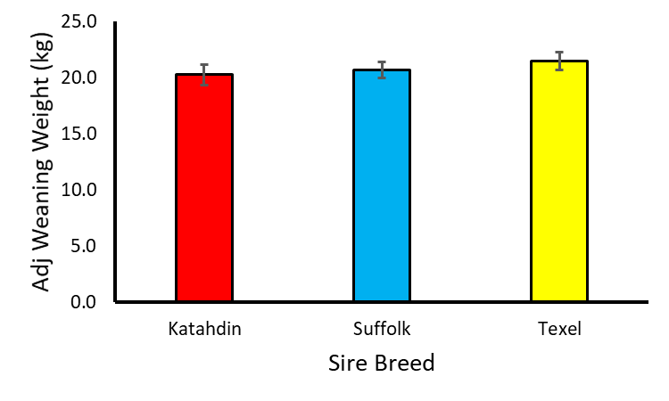
Adj. Weaning Weight
P = 0.55

Slide 12

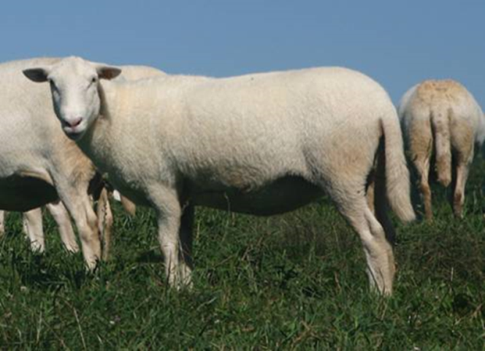
Pre-weaning Summary
No differences in NLB/NLW
Birth weights
  Texel-sired lambs heavier

Slide 13
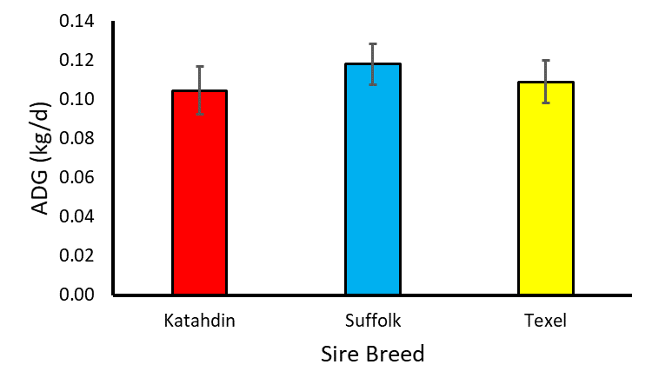
Grazing ADG
P = 0.78

Slide 14
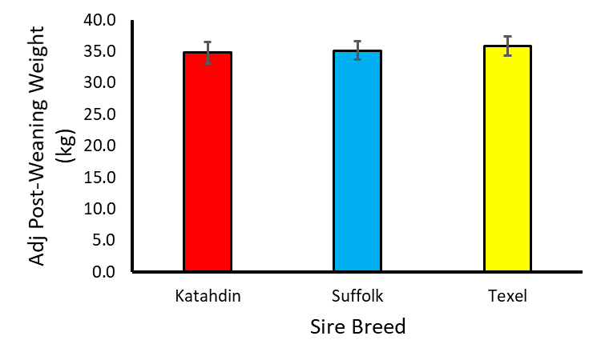
Adj. Post-Weaning Weight
P = 0.89

Slide 15
Growth Summary
No differences in growth performance

Slide 16
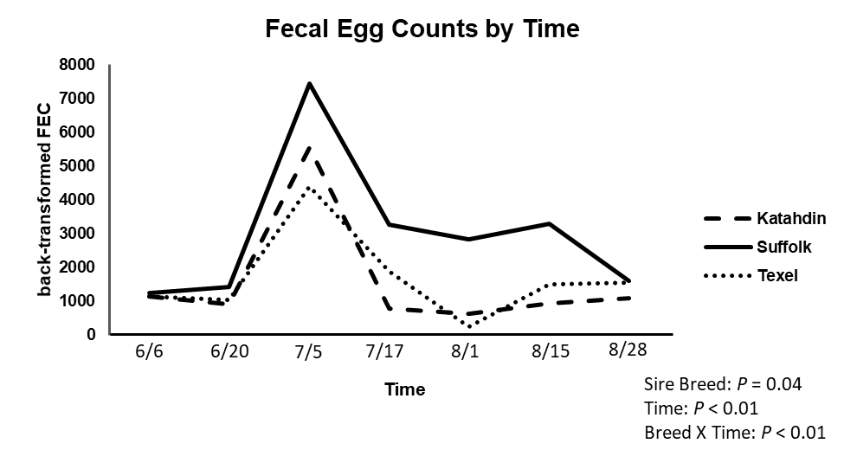
Fecal Egg Counts

Slide 17
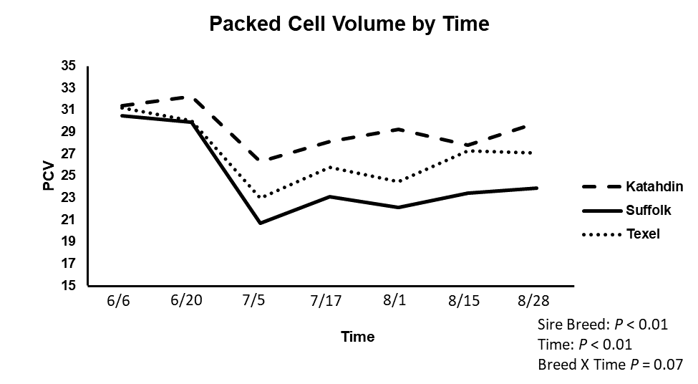
Packed Cell Volume

Slide 18
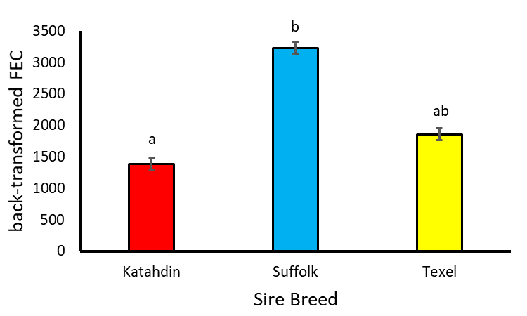
Average FEC and PCV over grazing period
P < 0.05

Slide 19
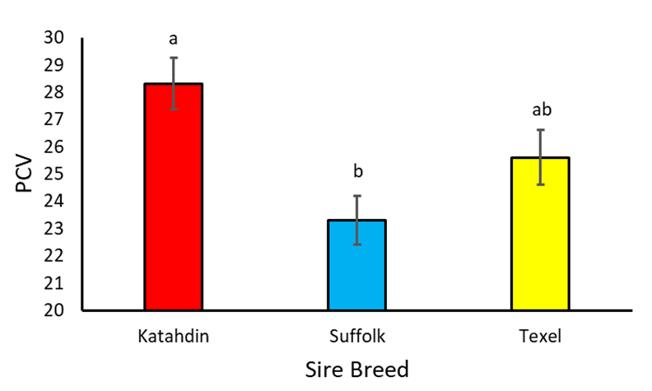
Average FEC and PCV over grazing period
P < 0.01

Slide 20

FEC and PCV Summary
Suffolk-sired lambs consistently greater FEC and lower PCV
Texel-sired intermediate to Katahdin and Suffolk-sired lambs for both traits

Slide 21
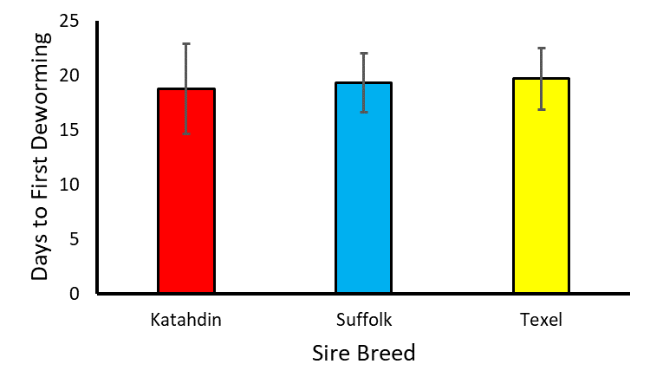
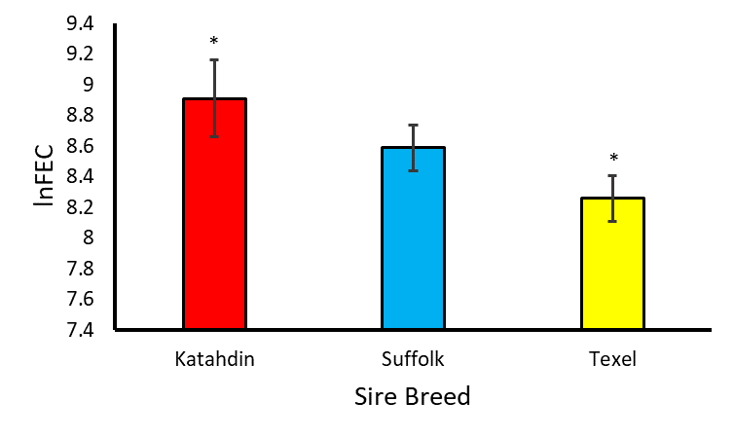
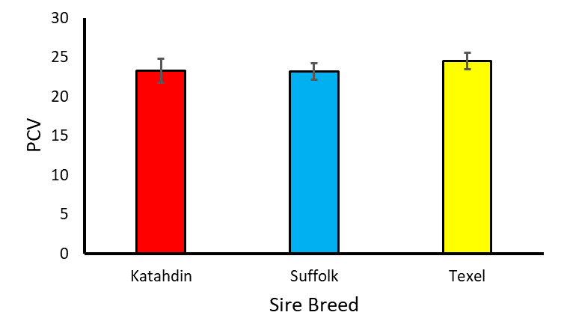
Days to Deworming
FEC at Deworming
P = 0.98
P = 0.06
PCV at Deworming
P = 0.66

Slide 22
At Deworming Summary
Katahdin lambs had the lowest deworming % and the greatest FEC at deworming (FAMACHA = 3)
No differences between sire breeds for days to deworming or PCV at deworming

Slide 23
Summary and Conclusions
Trait | Katahdin | Suffolk | Texel
Pre-weaning
Growth
FEC and PCV
Deworming
But…

Slide 24
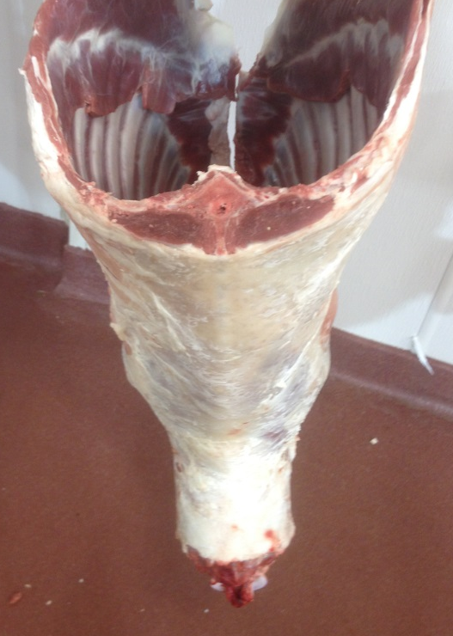
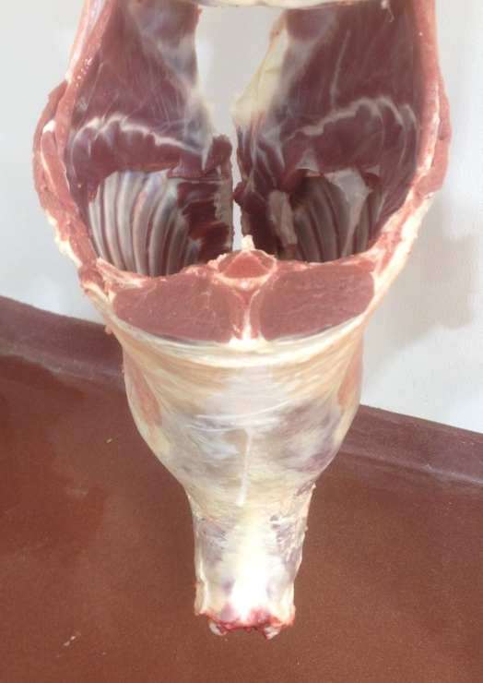

Slide 25
Summary and Conclusions
Trait | Katahdin | Suffolk | Texel
Pre-weaning
Growth
FEC and PCV
Deworming
Carcass Merit
Total | 3 | 1 | 4.5
Texel sires provide the best combination of growth and carcass composition while maintaining a level of parasite resistance in their progeny

Slide 26
Acknowledgements
Zajac Parasitology Lab
  Dr. Anne Zajac
  Kate Pouliot
  Lauren Page
Southwest Virginia Agricultural Research and Extension Center (Glade Spring, VA)
  Lee Wright
  Jessica McAllister
  Jerry Rhea
  Eric Rutherford

Slide 27

Questions

